Slide 1

Operators and Interactivity
Notes:
Welcome to Week 2 lesson 1 of Programming I. Our objective this week is to give you enough of the basics for you to start coding and doing interesting stuff. As we go through the remaining weeks of this module, we will examine the various concepts more thoroughly, but think of today as a sample platter of the yummy programming things you will be able to taste later.
Hmm, I’m hungry. Really shouldn’t be recording these before lunch.

Slide 2
Objectives
At the end of this lesson, you will learn about….
Strings
Operators
Program Interactivity
Python’s math module
Notes:
So what will we cover in this lesson? The first thing we want to do is briefly talk about Python strings, which is how Python handles text. This is because a lot of the interesting stuff that you can do in programming requires you to write text on the screen, so we’ll talk a bit more about how strings work. We also want to discuss operators. We’ll cover mathematical operators like plus, minus, times and divide; comparison operators like greater than or equal to; and logical operators like and, or and not. There are other operators, but we’ll just cover these today.
Another useful thing to learn is how to interact with a program, and today we will explain how you can allow the user to type stuff onto the screen for the program to process. Finally, for more advanced mathematical operations like sin, cosine, tangent and exponents, we have the standard math module supplied by Python. OK then, let’s get started.

Slide 3
Strings
Notes:
All right, first up we are going to explain a bit more about strings. The other basic data types are easy – integers are just whole numbers, floats are just numbers with decimal points, and Boolean values are either True or False. But strings are a little tricky, because they are made of multiple characters in sequence, and there are lots of things that you can do with strings.

Slide 4
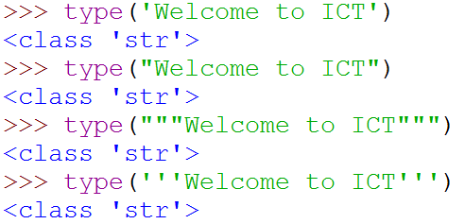
Strings
Strings in Python can be enclosed in either single quotes ('), double quotes (") or triple quoted (''' or """)
Notes:
In Python, strings can be expressed as sequences of characters in single quotes, double quotes or even triple quotes. Or even double double quotes. Or even triple double quotes. All these examples are valid ways to express the string “Welcome to ICT” in Python.

Slide 5
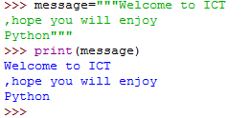
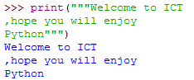
Strings
Triple quoted strings can even span multiple lines:
What is the expected output?
Notes:
Why bother with triple quotes? Who has that much time on their hands? The advantage of triple quoted strings is that they may span multiple lines, which means that you can write code like this and it will work, but single or double-quoted strings can’t do that.
Why bother with even double-quoted strings, then? To help you answer the question, try typing this into the Python shell. What is the output that you expect? What is the actual output? And can you think of a way that double-quoted strings can help?
OK, that’s all you need to know about strings for now. We will go into a lot more detail about strings in a future lesson.

Slide 6
Operators
Notes:
Let’s talk about operators now. Operators are things that you can do to data and values. There are lots of operators in Python.

Slide 7
Operators
Operators are symbols in programming languages to perform processing actions
Arithmetic Operators
Assignment Operators
Relational Operators
Logical Operators
operators
distance = speed * 2.7
operands
Notes:
In this lesson, we will go over a bunch of common operators in Python and explain how they work. We will talk about arithmetic operators like plus, minus, times and divide; the assignment operator (which you have already encountered) allows you to set the value of a variable; relational operators allow you to compare values; and logical operators that you can use to combine or negate values.
Incidentally, the things that operators act on are called “operands”. So in this expression, these are operators, and these are operands.

Slide 8
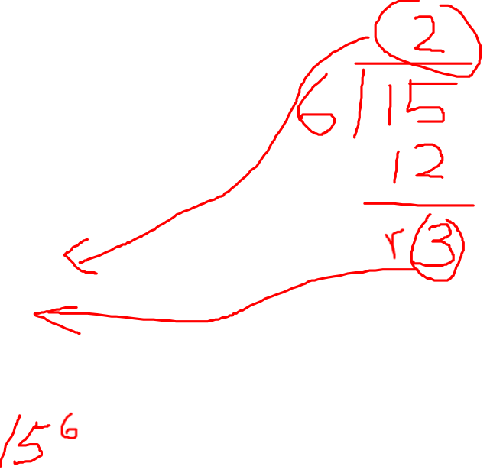
Arithmetic Operators
Operators | Example | Given y=15; z=6
+ addition | x = y + z
- subtraction | x = y – z
* multiplication | x = y * z
/ division | x = y / z
// floor division | x = y // z
% modulus/remainder | x = y % z
** exponentiation | x = y ** z
x = 21
x = 9
x = 90
x = 2.5
x = 2
x = 3
x = 11390625
Notes:
Let’s start with something you are probably familiar with, which is arithmetic operators. Well, sort of. The plus and minus are the same, but in Python multiplication is the asterisk, and divide is the slash.
We also have a couple of operators for integer division. What’s integer division? Remember in primary school when you a have to do your long division manually, and when you are given 15 divided by 6, and you end up with the answer as 2 remainder 3? So floor division, which is a double slash, is the integer result of the division, and the modulus operator, which is the percent sign, is the remainder.
There is also an exponentiation operation (or “to the power of”), which is two asterisks. So it turns out 15 to the power of 6 is 11 million 390 thousand 625. That’s useful to know.

Slide 9
Order of Arithmetic Operators
When more than one operator appears in an expression, the order of evaluation depends on the rules of precedence.
Order of precedence (highest to lowest) is:
Operator | Description
( ) | Parentheses (grouping)
** | Exponentiation (raise to a power) | right to left
* / // % | Multiplication, division, floor division, modulus | left to right
+ - | Addition, subtraction | left to right
= | Assignment
123.7704348
427008
29.6
512
34.5
value = 8.34 * (2 ** 3 ** 2) / (4.9 + 8 * 3.7)
9
Notes:
What happens when you have more than one operator in an expression? Which one do you do first?
All operators in Python have a precedence level as well as a direction. If you have complicated expression, Python will go down the precedence list and execute the ones with the highest precedence first. If multiple operators at the same precedence level are in an expression, then they are evaluated according the direction, either right to left or left to right.
This table shows you the precedence levels for some of the operators. So given these precedence levels, how is this equation evaluated? According to the precedence table, the highest precedence is parentheses (or brackets). We have two sets of these, and it does not really matter which one we do first, so let’s do this one first. In this expression, it is 2 to the power of 3 to the power of 2, so which operation do we do first? To decide, we look at exponentiation and see that the direction is right to left, so we actually do this one first, which gives us 2 to the power of 9. Then we evaluate this expression and get 512.
Next we look at the other parentheses. We see that multiplication has a higher precedence than addition, so we do 8 times 3.7 first, which gives us 29.6. Then we add these values together to get 34.5.
Now we end up with this equation, and we see that both times and divide have the same precedence, so we look at the direction. In this case, the direction is left to right, so we multiply 8.34 and 512 to get 427008, and then finally we do the division to get the final result of 123.77 something something. Finally we assign this number to the variable called value.
And that’s how you calculate like a computer.

Slide 10
Mathematical Formulae to Python
 | Mathematical Formulae | Python Statement
1. | y = ax + b
2. | y = (a + b) (a - b)
3. | y = 2[(a + b) (a - b)] - x
4.
5. | a = -b
y = a * x + b
y = (a + b) * (a - b)
y = 2 * ((a + b) * (a - b)) – x
y = 1 - (2 * a) / (3 * b)
a = -b
Notes:
Here are a few more examples of how to express mathematical equations in Python. If you want to express y = ax + b, you write it in this way. Note that you need to put the asterisk for multiplication – just writing ax will not work because Python will think it is an identifier called “ax”. Similarly, if you want to do y = (a+b)(a-b), you need the asterisk to explicitly tell Python to multiply the results of the two parentheses.
Another thing to note is that Python only uses round brackets for this purpose, so even though you can use square brackets in math, you can only use round brackets in python.
If you want to do fractions, brackets is how you do it. Put your numerator in one set of brackets, your denominator in another set, and put a slash in between to divide the first with the second.
Finally, to make a value negative, just put a minus sign in front, just like you would do it normally.

Slide 11
Assignment Operator =
Assigns value to variable
Assignment is from right to left
E.g. What is the value of k after each line?
k = 6
k = k + 1
adds 1 to value of variable k
assigns new value back to the variable k
Notes:
Next, let’s revisit the assignment operator. For Python, it’s a single equals sign. If you put a variable to the left of the assignment operator, and an expression to the right, it will set the value of the variable to become the result of the expression. So k = 6 sets the value of k to 6. It’s like magic.
Not only that, the assignment operator works from right to left. In this case, if you write k = k + 1, Python will first evaluate the right hand side. Since k was originally 6, k+1 becomes 7. Then, it will take this value of 7 and assign it to k, overwriting the original value. It’s like even cooler magic.

Slide 12
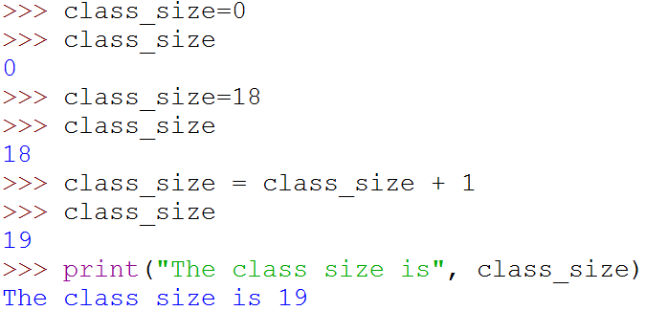
Assignment Statements
Variables can be reassigned as many times as you need during the execution of your program!
Notes:
Variables can be reassigned as many times as you need during the execution of your program. In this example, class size has an initial value of 0, then it has the value of 18, and then you can add 1 to it and it becomes 19. Crazy, right?

Slide 13
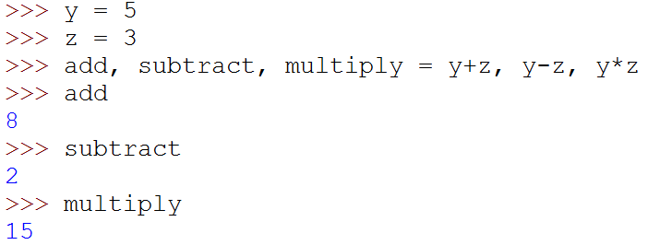
Simultaneous Assignment
Several values can be calculated at the same time
<var>, <var>, … = <expr>, <expr>, …
Evaluate the expressions in the RHS and assign them to the variables on the LHS
Notes:
In Python, you can perform more than one assignment in the same statement using the comma operator. In this example, we used commas to assign three variables with the results of three expressions, so add is given the value of y+z, subtract is given the value of y-z and multiply is given the value of – you guessed it – y * z. This can be useful and convenient later on when you are dealing with data that is composed of multiple different parts, like lists and tuples that we will cover later in this module. For now, keep this comma operator in mind.

Slide 14
Activity Break!
Lecture activities are in a separate file (Word document)
You are required to submit your solution for the activities in POLITEMall when you have completed all of them
Try to work on activity 1 now…
Notes:
Music from https://www.fiftysounds.com/royalty-free-music/marseille.html

Slide 15
Relational Operators
Relational operators compare the two operands and produce a Boolean value of either True or False.
Operator | Description
== | equal
!= | not equal
> | greater than
>= | greater than or equal
< | less than
<= | less than or equal
Notes:
Next, let’s talk about relational or comparison operators. These operators compare two operands and gives you a result of either True or False.
There are six of them:
Equal, which is represented by two equal signs to differentiate it from the assignment operator;
Not equal, which is represented by exclamation mark equals;
Greater than;
Greater than or equal;
Less than; and
Less than or equal

Slide 16
Logical Operators
Logical operators allow us to build more complex Boolean expressions from simpler Boolean expressions.
Logical Operator | Description
and | produces True only if both Boolean expressions are true
or | produces True if either of the Boolean expressions is true
not | Negates a Boolean value
Notes:
Python has three logical operators that are reserved keywords. These operators connect Boolean expressions to form compound Boolean expressions.
and will only return True if both Boolean expressions are True;
or is True whenever either of the two expressions is True. This means that or will also return True if both expressions are True. If it helps, think of or in Python as and/or;
Finally, not will return the opposite of its operand, so the result is False if the operand is True.

Slide 17
Order of Operators
Operator Precedence, from highest to lowest:
Operator | Description
( ) | Parentheses (grouping)
** | Exponentiation (raise to a power) | right to left
* / // % | Multiplication, division, floor division, modulus | left to right
+ - | Addition, subtraction | left to right
<, <=, >, >=, !=, == | Relational operators
not | Boolean NOT
and | Boolean AND
or | Boolean OR
Notes:
Now that we have covered more operators, let’s look at the operator precedence from highest to lowest. You must memorize this table, and also the precedence values of all other operators as you learn about them.
Just kidding! Who has the time to memorize all this? Here’s an important tip. Notice that parentheses has the highest precedence of all operators. When you are writing a complicated expression, when in doubt, always add parentheses to control the order of evaluating the operators. In fact, even if the parentheses are not necessary, there is no harm in adding them for the sake of clarity.

Slide 18
Activity Break!
Try to work on activities 2 & 3 now…
Remember to submit your solution to POLITEMall when you have completed all of them
Notes:
Music from https://www.fiftysounds.com/royalty-free-music/marseille.html

Slide 19
Type conversion
int(), float(), str(), and bool() convert to integer, floating point, string, and boolean (True or False) types
Example | Output
print(4.0 / 2.0) | 2.0
print( float(4) / float(2) ) | 2.0
print(int(4.0) / int(2.0)) | 2.0
print(int(4.0 / 2.0)) | 2
print (int(3.8)) | 3
print (str(3.1415926)) | 3.1415926
print(bool(0)) | False
print(bool(-1.7)) | True
Notes:
Sometimes it is necessary to convert values from one type to another. Python provides a few functions that will allow us to do that. The functions int, float, str and bool will convert their arguments into types integer, floating point, string and Boolean, respectively. This can sometimes be confusing, so let’s take a look at a few examples.
Suppose you have this statement, which prints 4.0 divided by 2.0. Since you are dividing a float with another float, you expect to get a float, which in this case is 2.0, which is what you get. So far so good.
With this statement, you are converting the integers 4 and 2 into floats before you divide them, so you should expect to get the same result, which you do. No problem.
Now, what if you divide 4.0 by 2.0, making sure to convert 4.0 and 2.0 into integers first? You’d expect to get the integer 2, right? Wrong. You in fact get the float 2.0. This is because the divide operator always returns a float.
So if you want to get an integer results after a division, you need to convert the result to integer, not the individual operands. So this statement will work as intended.
What happens when you convert a float into an int? In Python, this just chops of the decimal part, so if you convert 3.8 into an integer, you get 3. It does NOT round up to 4.
When you convert a numerical value into a string, it will create a string containing the appropriate characters for you. So this statement will display the string containing the characters 3, decimal point, and then the characters 1415926.
In Python, you can convert numerical values to Boolean, meaning True or False. The only number that corresponds to False is zero. Any other number corresponds to True (even if it’s negative).
Play around with these type conversions in Python and make sure you understand how they work. You will be doing lots of type conversion when you do your programming later.

Slide 20
Program Interactivity
Notes:
The next thing we will cover in this lesson is some basic program interactivity, so that you can let the user type something into the console to be used as input for your programs.

Slide 21
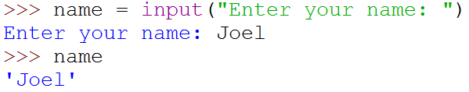
Program Interactivity
<variable> = input(<prompt>)
Built-in function in Python for getting input from user and store it into a variable.
First the prompt is printed
The input part waits for the user to enter a value and press <enter>
The expression that was entered is captured as a string of characters and is assigned to the variable.
Notes:
Programs often need to get data from the user. Python has a built-in function for this purpose, called input. Input takes in one parameter, which is the string prompt that is shown to request the input from the user. It then pauses program execution to allow the user to type in a line of input from the keyboard. Once the user presses the Enter key, the line is read and returned as a string. You can then use the assignment operator to store this as a string value.
This examples asks the user to enter their name, and then stores it in the variable name.

Slide 22
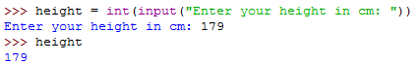
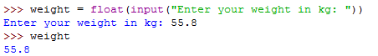
Assigning Input
You need to convert the string to int or float in order to use the numeric value.
Notes:
It is important to note that input always returns a string. If you are asking the user for a numerical value, you must convert the string into the correct numeric type if you want to do calculations on them. A common way is to wrap the input command in the correct conversion function, for example int or float.

Slide 23
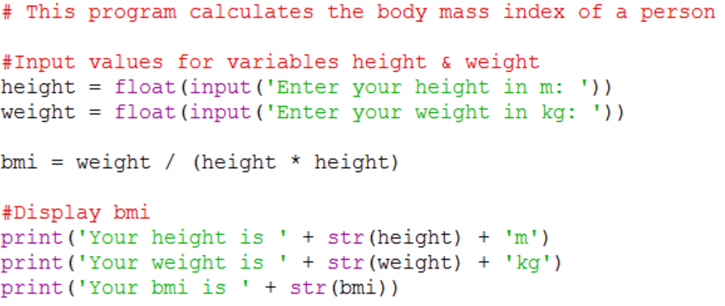
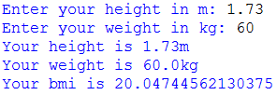
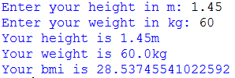
Example – CalBMI.py (assign inputs)
Output
Notes:
In this program, the user is asked to enter their height and weight as floats. The data entered are converted to float before being assigned to the variables height and weight, and this allows the program to do the correct bmi calculation.
What happens if you don’t convert the inputs into float? Try it out and see.

Slide 24
Activity Break!
Try to work on activity 4 now…
Remember to submit your solution to POLITEMall when you have completed all of them
Notes:
Music from https://www.fiftysounds.com/royalty-free-music/marseille.html

Slide 25
Math Functions
Notes:
OK, the final part of today’s lesson is to talk about math functions in Python. If you’re doing the simple stuff like plus, minus, times and divide, you can just go ahead and do it because Python provides that functionality by default. But if you are looking to do slightly more advanced math, like sin, cosine, tangent, exponents and square root, you need to import the math module.

Slide 26
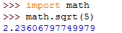
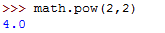
Math Functions
Python comes with a large number of modules of its own which have functions for different purposes
The math module provides mathematical functions for computation.
Usage: import math
Notes:
There are a huge number of modules in Python that allow you to do everything from complicated math and drawing graphs to extracting information from the Internet in real time and pushing notifications to your mobile phone. Today, we will talk about the math module, which gives you some additional mathematical functions to use. Since math is a module that is built into the basic Python installation, all you have to do to use it is write the code: import math. Once you do that, you can make use of various nifty mathematical functions like square root, pi and power. Notice that in order to use these function, you put math-dot in front of the function name.

Slide 27
Math Functions and Constants
Math function | Description
factorial(x) | Returns the factorial of x
ceil(x) | Returns the smallest integer greater than or equal to x.
exp(x) | Returns e**x
pow(x, y) | Returns x raised to the power y
sqrt(x) | Returns the square root of x
trunc(x) | Returns the truncated integer value of x
pi | Mathematical constant π, the ratio of circumference of a circle to its diameter (3.14159...)
e | Euler’s number, base of natural logarithm e (2.71828...)
Refer to: https://docs.python.org/3/library/math.html for other math functions
Notes:
Here are some common mathematical functions from the math module. For example,
The ceil function returns the ceiling of x, which is the smallest integer greater than or equal to x, and
The sqrt function returns the square root of x.
The math module also provides some common mathematical constants, including pi and e.
You can refer to the Python documentation to get the full list of math functions. Just Google it. You know what to do.

Slide 28
Activity Break!
Try to work on activity 5 now…
Remember to submit your solution to POLITEMall when you have completed all of them
Notes:
Music from https://www.fiftysounds.com/royalty-free-music/marseille.html

Slide 29
Summary
Strings
Operators
Program Interactivity
Use of Math Functions
Notes:
All right, that’s the end of this lesson. We did a quick introduction of how Python handles strings, we talked about various operators and their precedence levels, we introduced the input function that allows you to get input from users, and we talked about the math module that supplies some useful, slightly more advanced math functions. This should be enough to get you all started on doing some interesting stuff.

Slide 30
Reading Reference
How to Think Like a Computer Scientist: Learning with Python 3
Chapter 2
http://openbookproject.net/thinkcs/python/english3e/variables_expressions_statements.html
How the Python or Operator Works
https://realpython.com/python-or-operator/
The Python math Module: Everything You Need to Know
https://realpython.com/python-math-module/
Notes:
If you want to learn a bit more about the topics we covered today on your own, here are a few links you check out. Otherwise, thanks for listening and we’ll see you in class.

